Slide 1

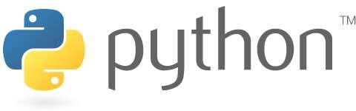
RECURSION
Prof. K. Adisesha
BE, M.Sc., M.Th., NET, (Ph.D.)

Slide 2

Learning objectives
Introduction
Recursive Functions
How Recursive Works
Recursive in Python
Recursive functions Examples
Recursive Vs Iteration

Slide 3
What Are Functions?
A function is a block of code which only runs when it is called.
Functions are sub-programs which perform tasks which may
need to be repeated.
Some functions are “bundled” in standard libraries which are part of any language’s core package. We’ve already used many built-in functions, such as input(), eval(), etc.
Functions are similar to methods, but may not be connected with objects
Programmers can write their own functions

Slide 4
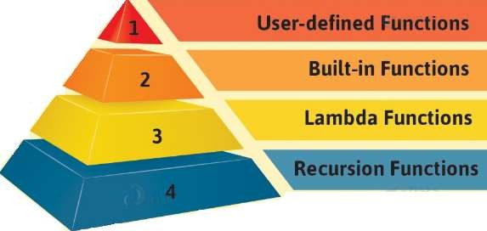
Types of Functions
Different types of functions in Python:
Python built-in functions, Python recursion function, Python lambda function, and Python user-defined functions with their syntax and examples.

Slide 5
Recursion
Recursion:
A technique for solving a large computational problem by repeatedly applying the same procedure to reduce it to successively smaller problems.
Recursion refers to a programming technique in which a function calls itself either directly or indirectly
Recursion is a common mathematical and programming concept.
A recursive procedure has two parts:
One or more base cases
A recursive steps.

Slide 6
Recursion
This has the benefit of meaning that you can loop through data to reach a result.
It means that a function calls itself.
Recursion can be two types:
Direct Recursion
Indirect Recursion
The developer should be very careful with recursion as it can be quite easy to slip into writing a function which never terminates, or one that uses excess amounts of memory or processor power.

Slide 7
Recursion
Direct Recursion: if function calls itself directly from its function body.
Example:
def recur():
recur() # function recur() calling itself
Indirect Recursion: if a function calls another function, which calls its caller function
Example:
def recur-A():
recur-B()
# function recur-A() calling recur-B(),
which calls recur-A()
def recur-B():
recur-A()

Slide 8
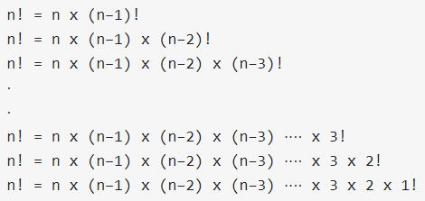
How Recursive Works
Overview of how recursive function works:
Recursive function is called by some external code.
If the base condition is met then the program do something meaningful and exits.
Otherwise, function does some required processing and then call itself to continue recursion. Here is an example of recursive function used to calculate factorial.
Example:
Factorial is denoted by number followed by (!) sign i.e 4!
Steps:
4! = 4 * 3 * 2 * 1
2! = 2 * 1
0! = 1

Slide 9
How Recursive Works
However, when written correctly recursion can be a very efficient and mathematically-elegant approach to programming.
Sensible Recursive code is the one that fulfills following requirements :
It must have a case, whose result is known or computed without any recursive calling -The BASE CASE.
The BASE CASE must be reachable for some argument/parameter.
it also have Recursive Case, where by function calls itself.
Example:
def factorial_recursive(n): # Base case: 1! = 1
if n == 1: return 1
# Recursive case: n! = n * (n-1)!
else:
return n * factorial_recursive(n-1) print("\n\n Recursion Example Results") factorial_recursive(6)

Slide 10
Recursive in Python
Writing a Recursive Function.
Before you start working recursive functions, you must know that every recursive function must have at least two cases :
The Recursive Case (or the inductive case)
The Base Case (or the stopping case)always required
The Base Case in a recursive program must be reachable that causes the recursion to end.
The Recursive Case is the more general case of the problem we're trying
to solve using recursive call to same function.
Example: function xn, the recursive case would be :
Power (x, n) = x * Power (x, n - 1)
The base cases would be: Power(x, n)=x when n=1 Power(x, n)=1 when n=0
Other cases(when n<0) ignoring simplicity sake

Slide 11
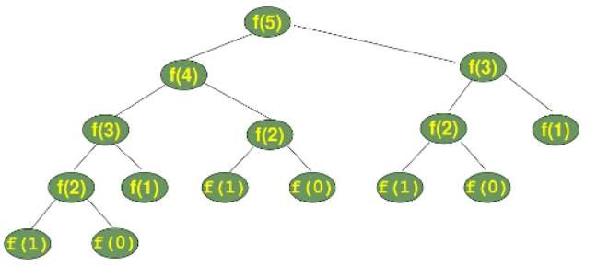
Recursive in Python
Writing a Recursive Function.
The Fibonacci numbers are easy to write as a Python function.
It's more or less a one to one mapping from the mathematical definition:
def fib(n):
if n == 0: return 0
elif n == 1: return 1
else:
return fib(n-1) + fib(n-2)
The order in which the functions are called. fib() is substituted by fib().

Slide 12
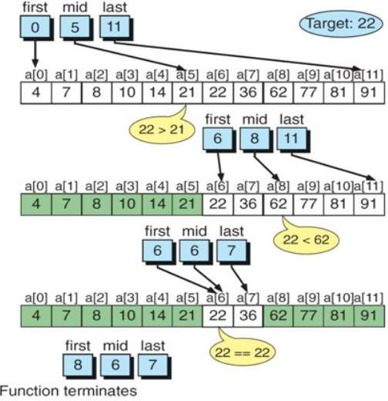
Binary Search
Binary Search Techniques.
Popular algorithm that used recursion successfully is binary search algorithm.
Binary search works for only sorted array whereas linear search work for both sorted as well as unsorted array.
The process of binary search is illustrated in the figure:

Slide 13
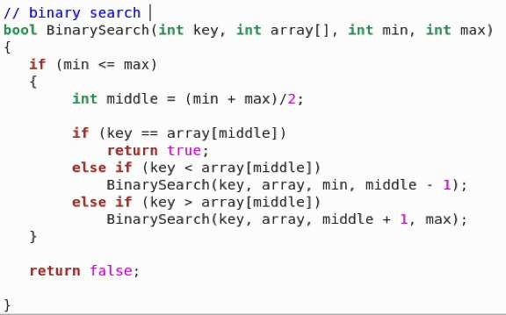
Binary Search
Binary Search Algorithm.
Popular algorithm that used recursion successfully is binary search algorithm.

Slide 14
Binary Search
Binary Search Algorithm.
Popular algorithm that used recursion successfully is binary search algorithm.

Slide 15
Recursion vs. Iteration
Difference between Recursion and Iteration
A program is called recursive when an entity calls itself.
A program is call iterative when there is a loop (or repetition).
PROPERTY | RECURSION | ITERATION
Definition | Function calls itself. | A set of instructions repeatedly executed.
Application | For functions. | For loops.
Termination | Through base case, where there will be no function call. | When the termination condition for the iterator ceases to be satisfied.
Usage | Used when code size needs to be small, and time complexity is not an issue. | Used when time complexity needs to be balanced against an expanded code size.
Code Size | Smaller code size | Larger Code Size.
Time Complexity | Very high(generally exponential) time complexity. | Relatively lower time complexity (generally polynomial-logarithmic).

Slide 16
Conclusion!
We learned about the Python function.
Recursive Functions
How Recursive Works
Recursive in Python
Recursive functions Examples
Recursive Vs. Iteration
Thank you

